Slide 1
AI-based Disaster Response System
Submitted in the partial fulfillment for the award of the degree of
BACHELOR OF ENGINEERING
IN
CLOUD COMPUTING
Submitted by-
Gurdeep 21BCS11844
Anuj Verma 21BCS11840
Samar Choudhary 21BCS9823
Under the Supervision of:
Ms. Tanvi
DISCOVER . LEARN . EMPOWER

Slide 2
Outline
Introduction to Project
Problem Formulation
Objectives of the work
Methodology used
Results and Outputs
Conclusion
Future Scope
References

Slide 3
Introduction to Project
AI-based disaster management systems are an innovative project designed to change how we manage and mitigate natural disasters. Utilizing advanced machine learning algorithms and real-time data analytics, the system aims to predict, assess and respond at risk and with unprecedented speed It includes data sources,social media feed and sensor networks combine to provide comprehensive and dynamic understanding of risk conditions to enable, optimize resource utilization, and ultimately save lives and reduce injuries. The AI-driven capabilities of the system allow for continuous learning and improvement, ensuring that over time it becomes more effective in handling the complexity of risk management

Slide 4
Problem Formulation
The trouble system for the AI-primarily based disaster reaction system makes a speciality of addressing the enormous challenges in modern-day disaster control practices. Traditional structures regularly conflict with not on time reaction times, restricted data integration, and an lack of ability to expect catastrophe impacts correctly. These limitations bring about inefficiencies, with lives misplaced and resources misallocated.
The trouble lies inside the need for a greater shrewd, responsive, and proactive method to disaster management. This requires a machine capable of processing sizeable quantities of diverse records in real-time, predicting disaster trajectories, assessing dangers, and facilitating fast, informed decision-making. The center project is growing an AI-driven solution that no longer simplest complements the rate and accuracy of catastrophe response however also continuously adapts to new records and evolving situations, ensuring that responses are as effective as viable.

Slide 5
Objectives of the Work
Develop an AI-pushed model which can as it should be expect the onset and progression of diverse herbal disasters, which include floods, earthquakes, and cyclones, by means of reading ancient records, climate styles, and actual-time inputs.
Build a robust platform that integrates multiple data sources, including satellite imagery, sensor networks, social media, and public reporting, to provide detailed and up-to-date information on the risk situation.
Use AI algorithms to analyze the severity and impact of hazards in real-time, to enable the efficient and effective distribution of emergency supplies, such as medical supplies, rescue teams and shelter
Utilize AI-powered automation and communication tools that streamline communication between different agencies and stakeholders involved in disaster management, reduce delays and ensure faster response.
To develop a system that continually learns from past and consequences of disasters, refining its predictive models and response strategies for accuracy and effectiveness over time.

Slide 6
Methodology used
The first step is to identify and collect various sources such as satellite images, weather stations, sensor networks, social media platforms, historical disaster records, etc. This information is very important for training on AI models to enable real-time analysis in disasters.
Different machine learning algorithms such as deep learning, decision trees, and clustering are explored to determine which one is best suited to predict and respond to different disaster scenarios The selection algorithm considers factors such as disaster type, type of information and velocity required as separation.
A scalable and flexible platform with real-time data feeds and user interfaces has been developed to integrate trained AI models. This platform serves as a central hub for data processing, analysis and decision-making during a disaster. It is designed to process large amounts of data and provide real-time insights to users.
The system is tested using simulated risk scenarios to assess its performance under real-world conditions. These simulations consist of various disaster events such as earthquakes, floods and hurricanes to see how well AI models predict outcomes and support decision-making
Once the system has been successfully tested, the system is deployed in a real-world environment, where it continuously monitors data feeds and provides disaster insights Applications include prioritization such as between servers and communications to ensure proper system performance.

Slide 7
Conclusion
AI-based disaster management systems represent a transformative development in disaster management, aiming to bridge the gap between the complexity of today’s disasters and the need for timely, precise responses between Harnessing the power of artificial intelligence, the system is designed to address the critical challenges faced using traditional approaches to risk management. Real-time information and less satellite imagery, sensor networks, social media feeds By integrating data sources including f, the system can provide a comprehensive and dynamic understanding of risk situations, and provide its predictive capabilities and operational efficiency have increased
Through a careful process of data collection, pre-processing and modeling, the system is set to provide valuable insights that enhance decision-making and facilitate response efforts Implementing advanced machine learning algorithms ensures that the system can accurately predict disaster events, realistically assessing their impact when Can This not only improves disaster management, but also significantly reduces loss of life and property damage .

Slide 8

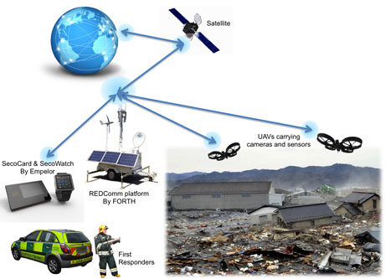
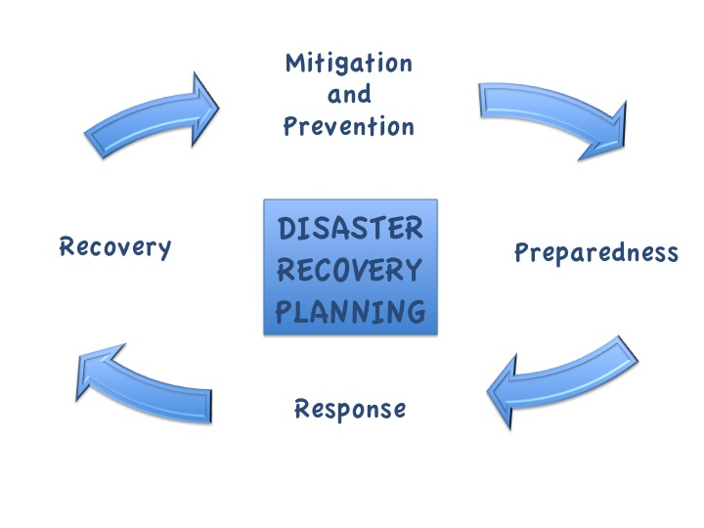
Future Scope
Future AI-based disaster management systems have exciting potential to further enhance their power and impact. As technology improves, system real-time processing and predictive accuracy can be greatly improved by integrating new features such as edge computing and more sophisticated AI models Extending systems with data from sources a emerging such as the Internet of Things (IoT) devices and next-generation satellite technology will be included to provide detailed and timely insights
This Photo by Unknown Author is licensed under CC BY-SA

Slide 9
References
A Modern Approach" by Stuart Russell and Peter Norvig: Provides foundational knowledge on AI techniques and algorithms, which can be essential for developing predictive models.
"A Survey of Machine Learning Techniques for Disaster Response" by A. B. Olsson, A. K. B. McCall, et al.: Reviews various machine learning approaches used in disaster response and their effectiveness.
"Artificial Intelligence in Disaster Management" by the International Federation of Red Cross and Red Crescent Societies (IFRC): Explores the role of AI in enhancing disaster response capabilities.

Slide 10
THANK YOU

